Slide 1
Option Pricing

Slide 2
Option Pricing
Learning Objectives:
Options Basics
The Put-Call Parity
Factors that affect option prices
Option Pricing I: Binomial Trees
Option Pricing II: Black-Scholes

Slide 3
1. Option basics
Understanding the valuation of financial options is useful for corporate finance:
1. Options are present in corporate securities
- Warrants, convertibles, executive stock options
2. Options are used for risk management purposes
3. In project evaluation: Most projects include embedded options
- Interim decisions regarding growth, liquidation, etc.

Slide 4
The Option Contract:
A contract in which the writer (seller) grants the buyer the right, but not the obligation, to trade with the writer an underlying asset at a fixed strike (exercise) price at or before an exercise (maturity) date
Call Option
Grants its holder the right to buy the underlying asset
Writer (seller) of the call option makes a commitment to sell the underlying asset at the strike price if the option is exercised
Put Option
Grants its holder the right to sell the underlying asset
Writer (seller) of the put option makes a commitment to buy the underlying asset at the strike price if the option is exercised
Options may be:
- Exercised, traded in the market, or allowed to expire

Slide 5
European vs. American Options
European options can be exercised only at the exercise date
American options can be exercised anytime between the date they are written and the exercise date
The “Moneyness” of an Option
“In the Money”: An option whose exercise would generate a profit, given the current market price of the underlying asset
Calls (puts) with exercise prices lower (higher) than the current price of the underlying
If the profit upon exercise is large, the option is said to be “deep in the money”
“Out of the Money”: An option whose exercise would generate a loss
Calls (puts) with exercise prices higher (lower) than the current price of the underlying
If the loss upon exercise is large, the options is said to be “deep out of the money”
“At the money”: The exercise price is roughly equal to the current price of the underlying

Slide 6
OPTIONS ON APPLE INC.
Option Type | Exercise Date | Strike Price | Option Price
Call | Sep 20, 2019 | $160 | $52.53
Call | Sep 20, 2019 | $210 | $7.61
Call | Sep 20, 2019 | $260 | $0.04
Put | Sep 20, 2019 | $160 | $0.19
Put | Sep 20, 2019 | $210 | $5.35
Put | Sep 20, 2019 | $260 | $64.05
Call | Jun 18, 2021 | $160 | $57.35
Call | Jun 18, 2021 | $210 | $31.11
Call | Jun 18, 2021 | $260 | $11.25
Put | Jun 18, 2021 | $160 | $11.10
Put | Jun 18, 2021 | $210 | $28.00
Put | Jun 18, 2021 | $260 | $71.00
Last trade prices as of noon, August 19, 2019. The stock price of Apple at that time was $211.48. All options are American options.

Slide 7
Option payoffs at expiration
Payoff Graph: Graph of the cash flow that the option would generate at the exercise date for each possible price of the underlying asset
- Important: the payoff graph does not include the option price
A. Call Options
Payoff of the call option at expiration:
Payoff to call owner = S_{T} − X if S_{T} > X
= 0 if S_{T} < X
where:
S_{T} = value of the underlying at expiration
X = Strike price

Slide 8
Example:
Call option on Apple, strike price X = $210:
Stock Price $200 $210 $250 $275 $300
Option Payoff $0 $0 $40 $65 $90
Payoff to call writer = – (S_{T} – X) if S_{T} > X
Payoff to call writer = 0 if S_{T} < X
BUY CALL
WRITE CALL
Option
Payoff
Option
Payoff
X
Underlying price
0
0
X
Underlying price

Slide 9
B. Put Options
Payoff of the put option at expiration:
Payoff to put owner = 0 if S_{T} > X
Payoff to put owner = X – S_{T} if S_{T} < X
BUY PUT
WRITE PUT
Option
Payoff
Option
Payoff
X
Underlying price
0
0
X
Underlying price

Slide 10
2. Put-Call Parity
Consider a European call and a European put with the same strike price X and the same expiration date T
Buy the call and write the put: What is the payoff from this portfolio?
Examine the two possible sets of scenarios:
S_{T} < X S_{T} >X
Payoff from call owned 0 S_{T} – X
Payoff from put written – (X – S_{T} ) 0
Total S_{T} – X S_{T} – X
So this position always nets a payoff of S_{T} – X

Slide 11
Portfolio Payoff
S_{T} – X
Long Call
S_{T}
X
Short Put

Slide 12
What is the value of this option portfolio?
Find a tracking portfolio that replicates the future payoffs. The value of the option portfolio must equal the price of the tracking portfolio if there is no arbitrage
The tracking portfolio (levered equity):
Borrow today and repay X at maturity
Buy one share of stock
The payoff of the tracking portfolio at time T is S_{T} – X
The tracking portfolio perfectly replicates the payoff of the option portfolio
Hence the tracking portfolio and the option portfolio must have the same value at date 0

Slide 13
The value of the option portfolio at date 0:
Purchase the call option for price C₀
Write (sell) the put option for price P₀
Total cost of establishing the position is C₀– P₀
The value of the tracking portfolio at date 0:
Borrowed funds: , Buy one share of stock: S₀
The value of the tracking portfolio is then
The option portfolio and the tracking portfolio must have the same value:
Put-Call Parity:

Slide 14
Remark: If Put-Call Parity is violated then an arbitrage opportunity exists
Example:
Consider T = 6 months
X = $105
Stock price = $110
Call price = $17, Put price = $5
Interest rate r_{f} = 10.25% annually (semi-annual yield 5%)
C₀ – P₀ = S₀ – 17 – 5 = 110 – 105/1.05
But 12 > 10 !
Put-call parity violated; arbitrage opportunity exists
Buy levered stock position and sell the option portfolio

Slide 15
3. Factors that affect option values
 | CALL | PUT
Stock price
Exercise price
Stock price volatility
Time to expiration
Interest rates
Dividend payout

Slide 16
4. Option Pricing I: Binomial Trees
Consider a stock and a European call on the stock one period before expiration:
Stock price in the up state
Current stock price
S₀
Stock price in the down state
Option payoff in the up state
Want to find the current option price
C₀
Option payoff in the down state

Slide 17
Valuation: The Tracking Portfolio (Replication) Approach
Example:
Value the call option on a stock: S₀ = $100; X =$125 and r_{f} = 8%
Binomial model: = $200
At year-end stock price can be:
= $50
So the call payoffs are
= $75 if stock price goes up, = $0 if it goes down
Alternatively consider the following tracking portfolio (see next slide for derivation):
(i) buy 0.5 shares of stock + (ii) borrow $23.15 at 8%
The tracking portfolio payoffs
$75 if stock price goes up ( 0.5 × 200 – 1.08 × 23.15 = 75)
$0 if it goes down ( 0.5 × 50 – 1.08 × 23.15 = 0)
The price of the portfolio = 0.5 × $100 – $23.15 = $26.85
So, by no-arbitrage: C₀ = $26.85

Slide 18
How did we find the tracking portfolio?
We want to find the tracking portfolio that replicates the call option’s payoffs
Suppose we buy Y shares of the stock and invest $Z in the bond:
Solving these two equations gives Y = 0.5 and Z = – 23.15

Slide 19
Risk-Neutral Probabilities: An alternative method to compute the option price
Procedure:
Solve for q: the probability that equates the underlying asset’s expected return to the risk-free rate:
General formula:
In the example:
2. Price the option using the risk-neutral probability and the risk-free rate:

Slide 20
Remarks:
The risk-neutral probability method is mathematically equivalent to the tracking portfolio method: they always result in the same answer
Intuition behind risk-neutral pricing:
Since an option is priced by no-arbitrage, risk premiums in the market (and in particular, the expected return of the stock) are irrelevant for the option price
Therefore, one may value the option as if risk premiums are zero (i.e., as if all assets earn the risk-free rate on average)
Important: The risk-neutral probability q is not an actual probability; it does not indicate the actual likelihood of the up state. It is just a mathematical tool
In class exercises, we will mostly use the tracking portfolio method, but all the exercises can be solved with the risk-neutral probability method as well

Slide 21
Generalization of binomial trees
S₀ , C₀
…and so on
Binomial tree approach is very flexible:
By choosing the time interval short enough, one can closely approximate the actual stock price movements (see slide # 30)
Can incorporate different interest rates or volatilities at different branches of the tree
Can be used to value any derivative security: In particular, those with interim payoffs where early exercise is possible (e.g., an American option on a dividend paying stock – see next)
Easy implementation given modern computing power

Slide 22
Example: Valuing an American Call Option on a Dividend-Paying Stock
A dividend-paying stock has the following price tree:
The interest rate is 5% per year
Find the year-0 value of an American call option with a strike price of $90 maturing at year 2
Note: The option holder collects the year-1 dividend on the stock only if the option is exercised in year 1
Year 0
Year 1
Year 2

Slide 23
Aside: American Call Option on a Non-Dividend-Paying Stock
If the underlying stock does not pay dividends, it is never optimal to exercise an American call option early (better alive than dead!)
Why?
Suppose you exercise early. There are two things you can do:
Exercise and hold the stock, say, until some future date T
But you would be better off if you wait and exercise at T (or at maturity if maturity is before T), since you would pay the strike price later (i.e., you save the interest on the strike price)
Exercise and immediately sell the stock
But you would be better off if you short-sell the stock, wait until maturity, exercise the option at maturity, and deliver the stock to close your short position (again, you would save the interest on the strike price)
In fact, in both cases, you can do even better by not exercising the option if the stock price at maturity is below the strike price
This logic breaks down for dividend-paying stocks, since the only way to collect the dividend is to own the stock

Slide 24
Answer
Step 1: Calculate the option payoffs at maturity
Year 0
Year 1
Year 2
Note: C^{up} and C^{down} refer to option values in year 1 assuming that the option is not exercised

Slide 25
Step 2: Find the year-1 value of the option in the “up” and the “down” states
a) In the “up” state:
Stock Option
Tracking portfolio: Buy Y shares of the stock and invest Z in the bond to replicate option payoffs

Slide 26
b) In the “down” state:
Stock Option
Tracking portfolio: Buy Y shares of the stock and invest Z in the bond to replicate option payoffs

Slide 27
Now we have
Year 1 up state
Year 0
Year 2
Year 1 down state
Note: C^{up} and C^{down} refer to option values in year 1 assuming that the option is not exercised

Slide 28
Should we exercise or keep the option open in year 1?
Exercise Don’t exercise
up state: 130 – 90 = $40 C^{up} = $34.29
down state: 90 – 90 = $0 C^{down} = $5
So, the optimal exercise strategy is “exercise” in the up state and “keep the option open” in the down state
Collect the dividend
Miss the dividend

Slide 29
Step 3: Find the year-0 value of the option
Stock Option
Tracking portfolio: Buy Y shares of the stock and invest Z in the bond to replicate option payoffs

Slide 30
How do we construct the binomial trees?
Binomial trees can be constructed by approximating the statistical process the underlying asset follows (see sections 7.5 and 8.7 in the book for details)
Procedure: Estimate the return standard deviation σ of the underlying asset from past data, then calculate
and d = 1/u, where T/N = # of years per binomial period
Example: Annual return standard deviation σ = 40%, quarterly binomial periods
Then:
T/N = ¼ since we want quarterly binomial periods

Slide 31
5. Option Pricing II: Black-Scholes Formula
Black-Scholes formula gives the value of a European call option in the continuous-time case
This is the same value one would obtain with binomial trees if the time intervals in the binomial model are taken to be very small
where:

Slide 32
Elements of Black-Scholes Formula
C₀ = Current call option value
X = Exercise price
S₀ = Current stock price
e = 2.7183
r_{f} = Annual interest rate
T = Time to maturity (in years)
ln = Natural logarithm
N(d) = Probability that a random draw from a standard normal distribution will be less than d
σ = Standard deviation of stock’s annualized continuously compounded return

Slide 33
Example: Using the B-S formula
Find value of European call option with the following data:
The B-S formula is then used as follows:
T = 98 / 365 = 0.26849
98 days to maturity | r_{f} = 0.05 | σ = 0.36983
X = 20 | S₀ = $27.66 | Zero dividends

Slide 34
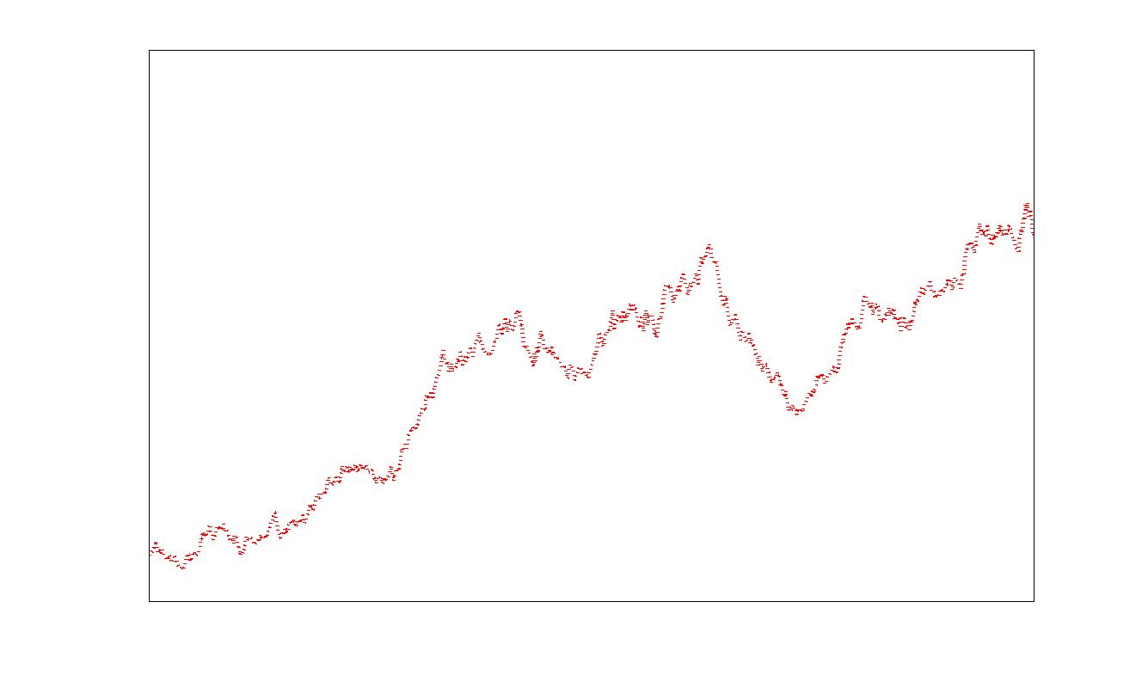
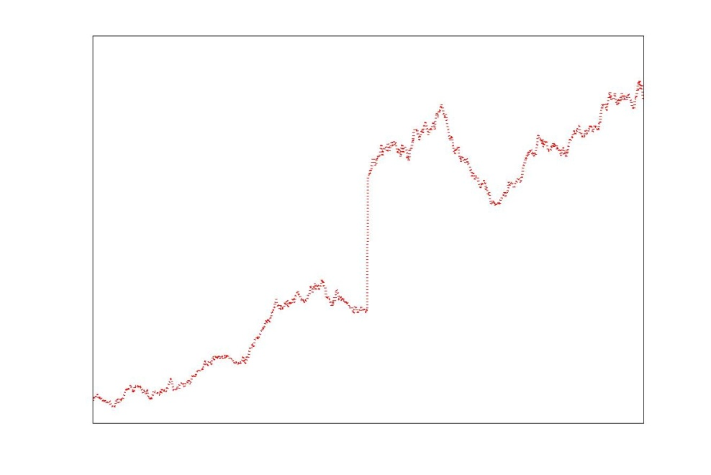
Remarks:
1. Assumptions required for the Black-Scholes formula to be valid:
European call option without dividends (can be adjusted if the dividend yield is known)
Both the interest rate r_{f} and volatility σ are constant through time
Stock price changes are continuous (this could be violated if big announcement effects are likely, e.g. a takeover announcement may occur and create a “jump” in the stock price)
Stock prices must look like this
Not like this

Slide 35
Remarks:
2. The value of σ that makes observed call option price consistent with the Black-Scholes formula is called the implied volatility
Known parameters
Observed market value of the option
Implied volatility, solved by inverting the Black-Scholes formula

